Slide 1
Search Strategy: Uninformed Search
Session 04
Henry Lucky, S.Kom., M.Kom.

Slide 2
Learning Outcomes
Session 4
At the end of this session, students will be able to:
LO 2: Apply various search algorithms for agents to solve problems

Slide 3
outline
Session 4
Search heuristics
Informed Search

Slide 4
Search heuristics
Heuristics
A heuristic is a practical approach or problem-solving method designed to produce a solution that is "good enough" for the problem at hand,
  particularly when finding an optimal or exact solution is impractical or computationally expensive.
Heuristics rely on experience, intuition, or rules of thumb to simplify the decision-making process.

Slide 5
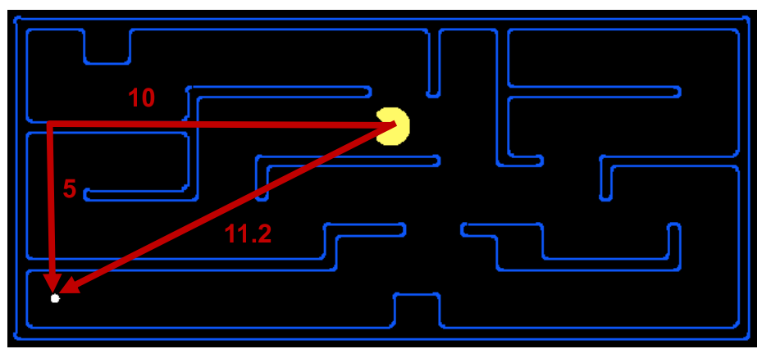
Search heuristics
Heuristics in search
In searching, a heuristic is:
  A function that estimates how close a state is to a goal
  Straight line distance between a point to a goal
  Designed for a particular search problem
  Examples: Manhattan distance, Euclidean distance for pathing

Slide 6
Informed Search
Definition
Uninformed search strategies look for solutions by systematically generating new states and checking each of them against the goal
This approach is very inefficient in most cases
Most successor states are “obviously” a bad choice
Such strategies do not know that because they have minimal problem-specific knowledge
Informed search strategies exploit problem-specific knowledge as much as possible to drive the search
They are almost always more efficient than uninformed searches and often also optimal

Slide 7
Informed Search
Definition
Main Idea
  Use the knowledge of the problem domain to build an evaluation function 𝑓
  For every node n in the search space, 𝑓(𝑛) quantifies the desirability of expanding 𝑛 in order to reach the goal
  Then use the desirability value of the nodes in the fringe to decide which node to expand next

Slide 8

Informed Search
Greedy best first search
Greedy best-first search tries to expand the node that is closest to the goal.​
  Thus, $f\left(n\right)= h\left(n\right)$
We use straight line distance heuristic (hSLD).

Slide 9
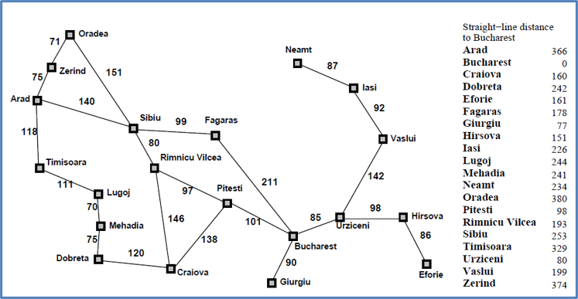
Informed Search
Greedy best first search

Slide 10

Informed Search
Greedy best first search

Slide 11
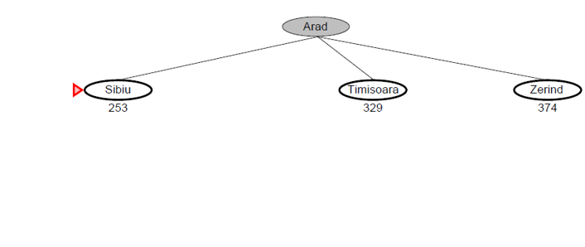
Informed Search
Greedy best first search

Slide 12
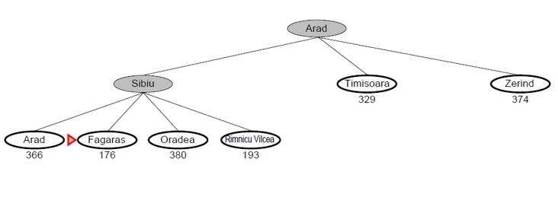
Informed Search
Greedy best first search

Slide 13
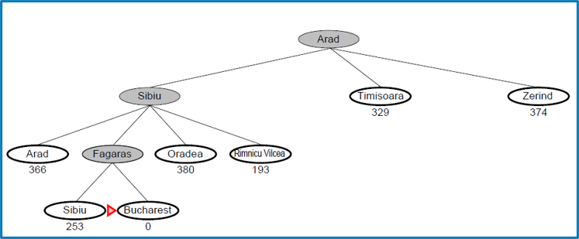
Informed Search
Greedy best first search

Slide 14
Informed Search
A*
Greedy best-first search
  Minimizes estimated cost h(n) from current node n to goal
  Is informed but almost always suboptimal and incomplete
Uniform Cost Search
  Minimize actual cost g(n) to current node n
  Is, in most cases, optimal and complete but uninformed
A* search
  Combine the two by minimizing f(n)=g(n) +h(n)
  Is, under reasonable assumptions, optimal and complete, and also informed

Slide 15
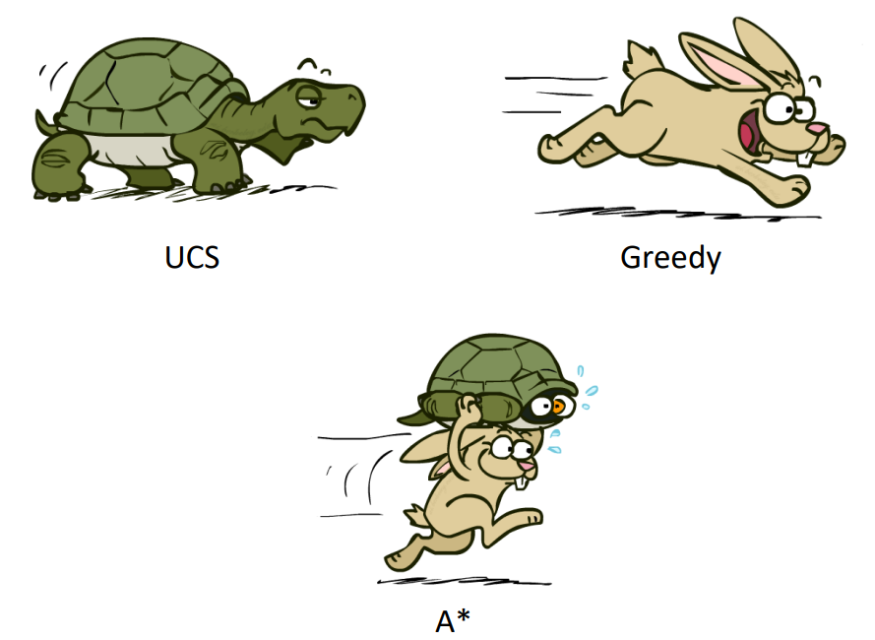
Informed Search
A*

Slide 16
Informed Search
A*
Idea: avoid expanding path that are already expensive
Evaluate function: 𝑓(𝑛) = ℎ(𝑛) + 𝑔(𝑛)
  𝑓(𝑛) : estimated total cost of path through n to goal
  ℎ(𝑛) : estimated cost to goal from n
  𝑔(𝑛) : cost so far to reach n

Slide 17

Informed Search
A*

Slide 18
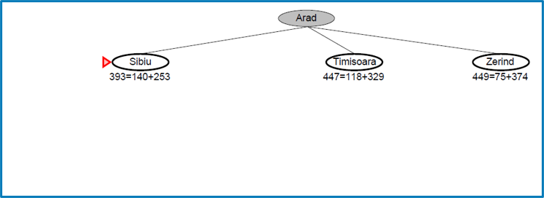
Informed Search
A*

Slide 19
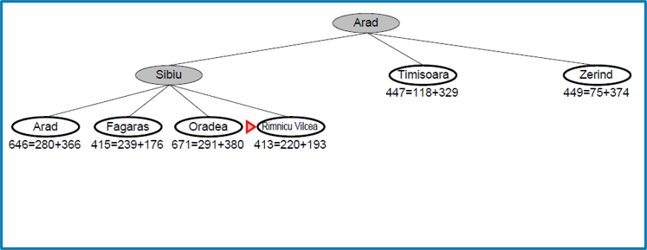
Informed Search
A*

Slide 20
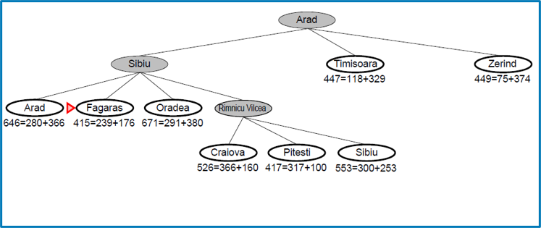
Informed Search
A*

Slide 21
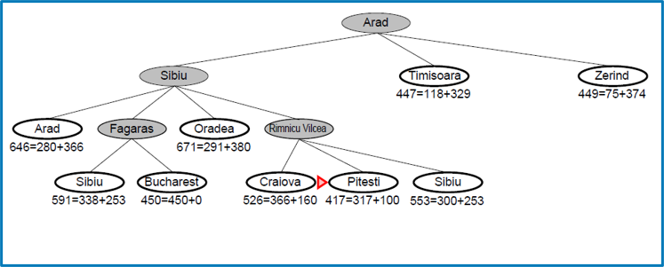
Informed Search
A*

Slide 22
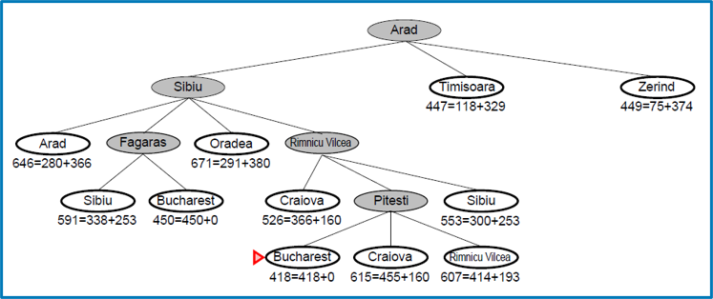
Informed Search
A*

Slide 23
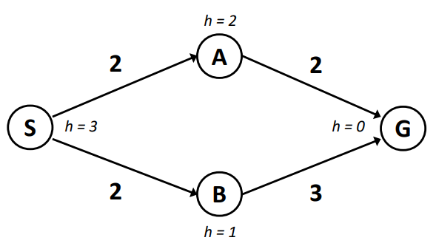
Informed Search
A*
Now, consider this graph:
Using A*, should it output the path S->B->G or S->A->G?
It should output S->A->G with total cost of 4, because the algorithm only terminates once the Goal is dequeued, not enqueued.

Slide 24
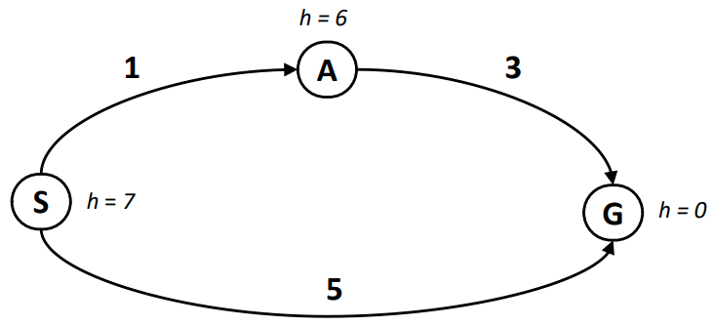
Informed Search
A*
Another consideration:
Using A*, how much is the cost found to go from S to G?
What do you think is the optimal cost? It should be 4.
Does it mean A* is not optimal? What’s wrong with the graph?

Slide 25
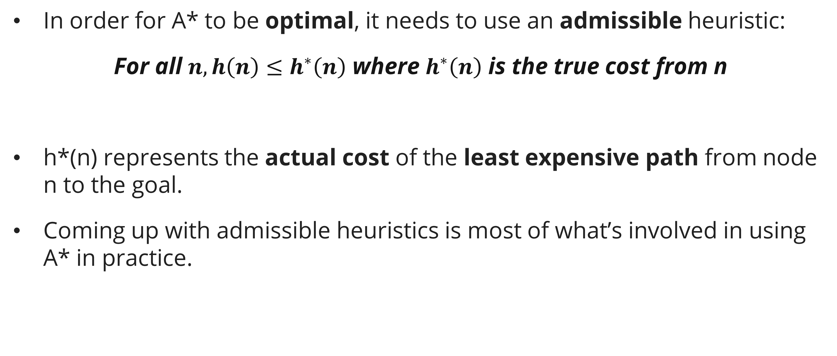
Informed Search
A*: Admissible heuristic
In order for A* to be optimal, it needs to use an admissible heuristic:
For all $n, h\left(n\right)≤h^{∗}\left(n\right)$ where $h^{∗}\left(n\right)$ is the true cost from n
h*(n) represents the actual cost of the least expensive path from node n to the goal.
Coming up with admissible heuristics is most of what’s involved in using A* in practice.

Slide 26
Informed Search
A*: Admissible heuristic
Using the same graph, let’s see how to make the heuristic admissible
Firstly, h(S) cannot be 7 because the true cost h*(S) is 4. So, h(S) should be <= 4 to be admissible.

Slide 27
Informed Search
A*: Admissible heuristic
Using the same graph, let’s see how to make the heuristic admissible
Secondly, h(A) cannot be 6 because the true cost h*(A) is 3. So, h(A) should be <= 3 to be admissible.

Slide 28
Case study
Simulating searching
h(A) = 8.0
h(B) = 9.0
h(C) = 7.0
h(D) = 5.0
h(F) = 4.0
h(H) = 2.0
h(G) = 0
h(J) = 3.0
h(I) = 1.0

Slide 29
Case study
Simulating searching
Simulate the node expansion from start state (S) to reach goal state (G)​
  Using Greedy, A*​
Do you think the heuristic function is admissible? Why?

Slide 30
References
Session 4
Russell, S. J., Norvig, P., Chang, M., Devlin, J., Dragan, A., Forsyth, D., Goodfellow, I., Malik, J., Mansinghka, V., Pearl, J., & Wooldridge, M. J. (2022). Artificial intelligence: A modern approach (Fourth edition, global edition). Pearson.
Tinelli, C. (2017). Informed Search. CS:4420 Artificial Intelligence. https://homepage.cs.uiowa.edu/~tinelli/classes/4420/Spring17/notes/3b-informed-search.pdf
Bacchus, F. (n.d.). Search. CSC384 Introduction to Artficial Intelligence. Retrieved October 20, 2023, from https://www.cs.toronto.edu/~fbacchus/csc384/Lectures/csc384-Lecture02-Search.pdf
Cohen, M., Allen, C.. Search: Informed Search - A* and Heuristics (Cam). CS188: Artificial Intelligence. https://inst.eecs.berkeley.edu/~cs188/sp24/assets/lectures/cs188-sp24-lec03.pdf

